Slide 1


CRYPTOCURRENCY
INTELLIGENCE
ANALYSIS_
PRESENTED BY JORGE DAVID BETANCOURT
T.ME/CRYPTOGEMINTEL

Slide 2

How can we incorporate the power of data science & NLP to assist in information gathering to assess profitable trading opportunities?
CIA
Data Science & Cryptocurrency Trading

Slide 3

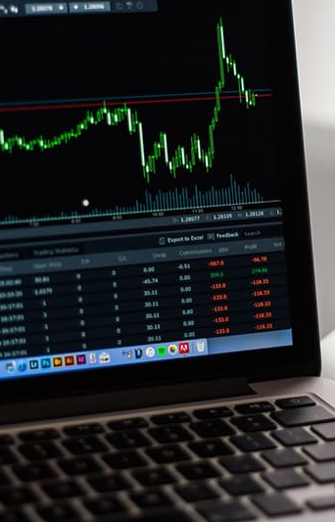
Methods of Application
01
MARKET STRENGTH METER
02
TWEETS INTEL STRATEGY
By combining my knowledge in technical analysis and trading with a faster, and more efficient approach of gathering in visualizing data, I have designed 3 different trading strategies, along with a market meter, that will assist in short-to-mid-term investing decisions.
03
UPCOMING EVENT
INTEL STRATEGY
04
TELEGRAM INTEL STRATEGY
Your Easy-to-use Map Building Tools

Slide 4

DISCLAMER:
This project will show examples of live trades that I am currently taking. None of this should be taken as financial advice. Everything mentioned is my own personal opinion. Examples presented here should be viewed as educational only.

Slide 5
MARKET STRENGTH METER
Data Science & Cryptocurrency Trading

Slide 6

MARKET STRENGTH METER
Data Science & Cryptocurrency Trading

Slide 7

What is a Market Strength Meter & why is it useful?
Python Libraries
Pandas
HVPlot
Pathlib
Numpy
Other Platforms
Bitcoin Dominates About 40% of the Total Crypto Market Cap
Used to Detect Periods of Optimal Day & Swing Trading
Can Help Distinguish Between Bear & Bull Markets
Can Help us from Entering Risky Trades & Taking Unnecessary Losses
Can Help Determine when it’s Time to Lock-In Profits
TradingView
Market Data

Slide 8

How does it work?
The Market Strength Meter uses 10 different crypto tickers & market indecies:
(BTC) Bitcoin
(TOTAL) Total Cryptocurrency Market Cap
(TOTAL2) Total Cryptocurrency Market Cap Excluding Bitcoin
(TOTAL3) Total Cryptocurrency Market Cap Excluding Bitcoin & Ethereum
(ETH/BTC) Ethereum against Bitcoin Trading Pair
(BTC3S) 3X Leverage Short BTC Coin On KuCoin
(BTC.D) Ratio Between Bitcoin Market Cap Against the Rest of the Market
(USDT.D) Ratio Between Tether Market Cap Against The Rest of the Market
(ETH.D) Ratio Between Ethereum Market Cap Against the Rest of the Market
(OTHERS.D) Ratio between the market cap of cryptocurrencies excluding large cap alt coins, BTC, & ETH

Slide 9
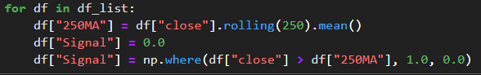
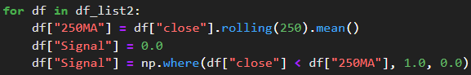
On 12 Hour Chart For Each Ticker
BTC, TOTAL, TOTAL2, TOTAL3, ETH.D, OTHERS.D, ETH/BTC
250 MA > Closing Price = 1 Point
Closing Price > 250 MA = 1 Point
BTC3S, USDT.D, BTC.D

Slide 10
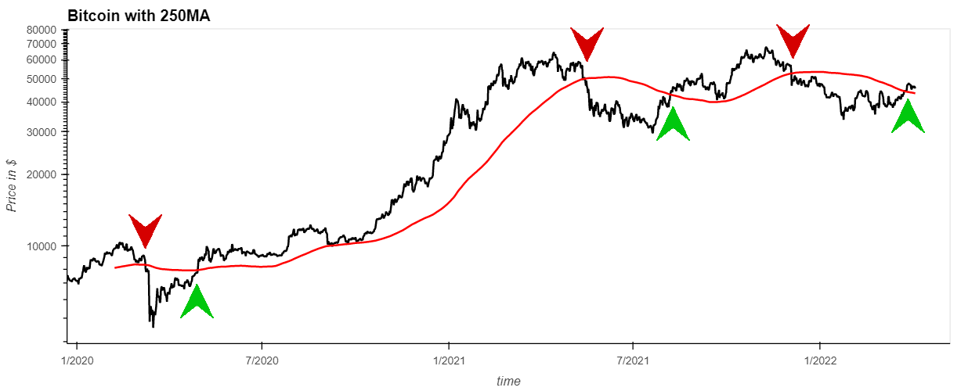
Bitcoin Chart with 250-Moving Average
Closing Price > 250MA = +1 Point (Market Bullish)

Slide 11
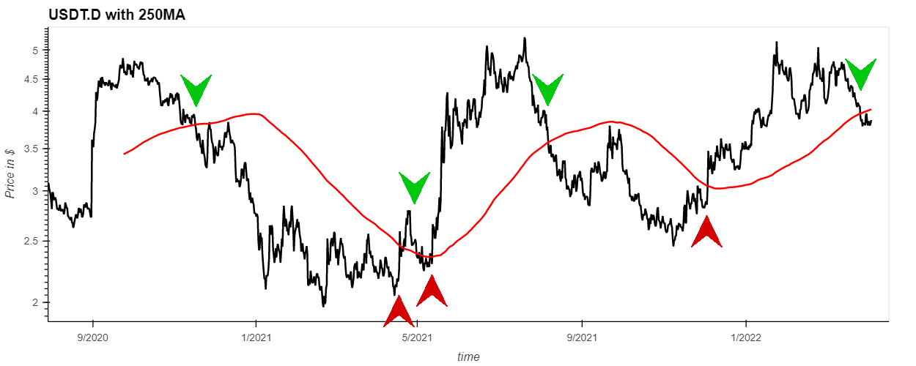
USDT.D Chart with 250-Moving Average
250MA > Closing Price = +1 Point (Market Bullish)

Slide 12
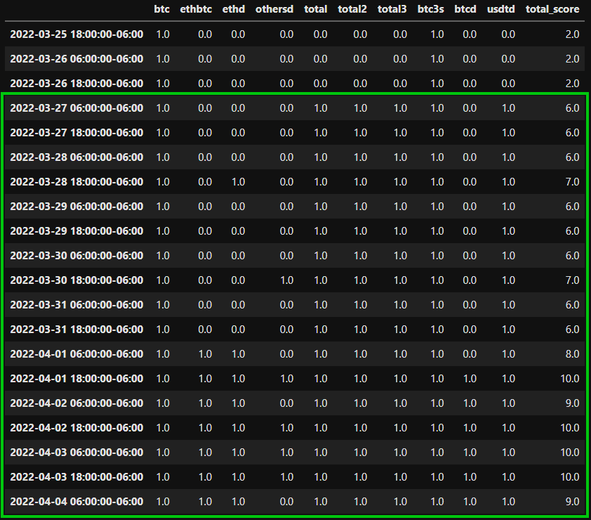
1–3 = BEAR MARKET
4–6 = NEUTRAL MARKET
7–9 = BULL MARKET
10 = TAKE PROFIT

Slide 13
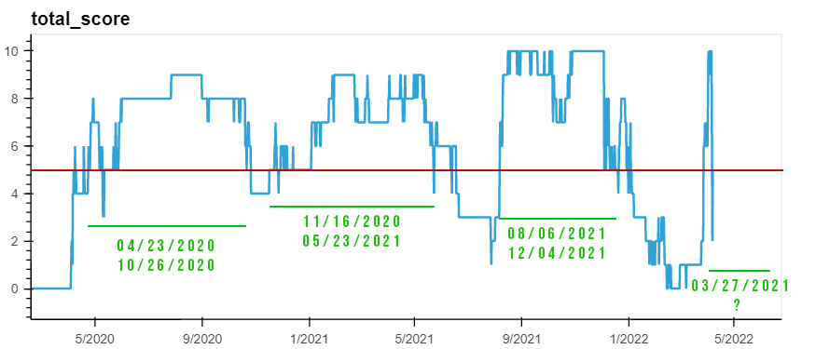
Periods of Optimal Trading

Slide 14
What can be done better?
Use TradingView API to pull data
Optimize Moving Averages that are specific for each market index
Experiment with different time frames to see which one works best for each
Incorporate sentiment data to gain a better understanding of the position of the market

Slide 15
TWEETS INTEL STRATEGY
Data Science & Cryptocurrency Trading

Slide 16
Why are tweets important in influencing trading decisions & how to incorporate them into a trading strategy?
v
Python Libraries
Pandas
Twint
Pathlib
NLTK
Re
Counter
Other Platforms
Cryptocurrency projects may post about important events to their users or fanbase
Crypto fans FOMO into a crypto based on significant tweets
Experienced traders frontload news events that will happen in the future
Can increase the chances of successful trade when applying technical analysis
TradingView
Twitter

Slide 17
How does tweet intel strategy work?
Coins on the KuCoin Exchange only
over 370 currencies are scraped for their tweet content
That data is then processed and filtered
A list of tweets is generated that can be manually looked over and researched
If coin has significant news, then a trade can be made based on the current technical analysis of that crypto project

Slide 18

What am I looking for?
Upcoming:
Mobile Apps
Testnets
Partnerships
Mainnets
Roadmap Updates
NFT Marketplace
Launch
Token release, etc.

Slide 19

57K Tweets Scraped
Over 370 Twitter Accounts
Since Jan 1st 2022

Slide 20
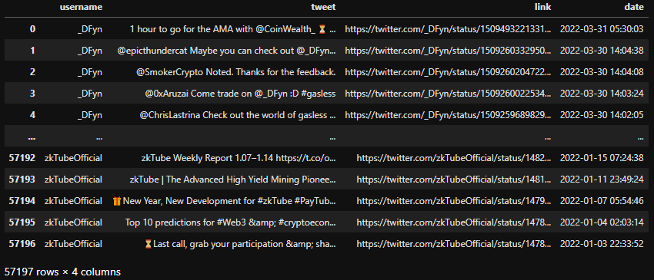
All Tweets From Over 370 Accounts

Slide 21

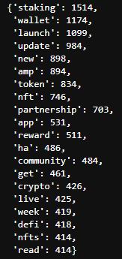
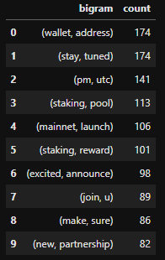
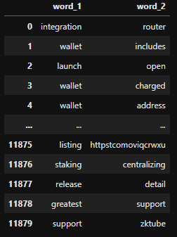
Tokenize
Create Bigrams
Filter & Sort

Slide 22
Bigram Keyword Filter
INTEGRATION
APP LAUNCH
TESTNET
UPDATE
TESTNET LAUNCH
APP
MAINNET
ROADMAP UPDATE
COMING SOON
PARTNERSHIP
ROADMAP
MAINNET RELEASE
RELEASE
PARTNERSHIP
ANNOUNCEMENT
28 Manually Picked Keywords
65 Bigram Relevant Keywords

Slide 23
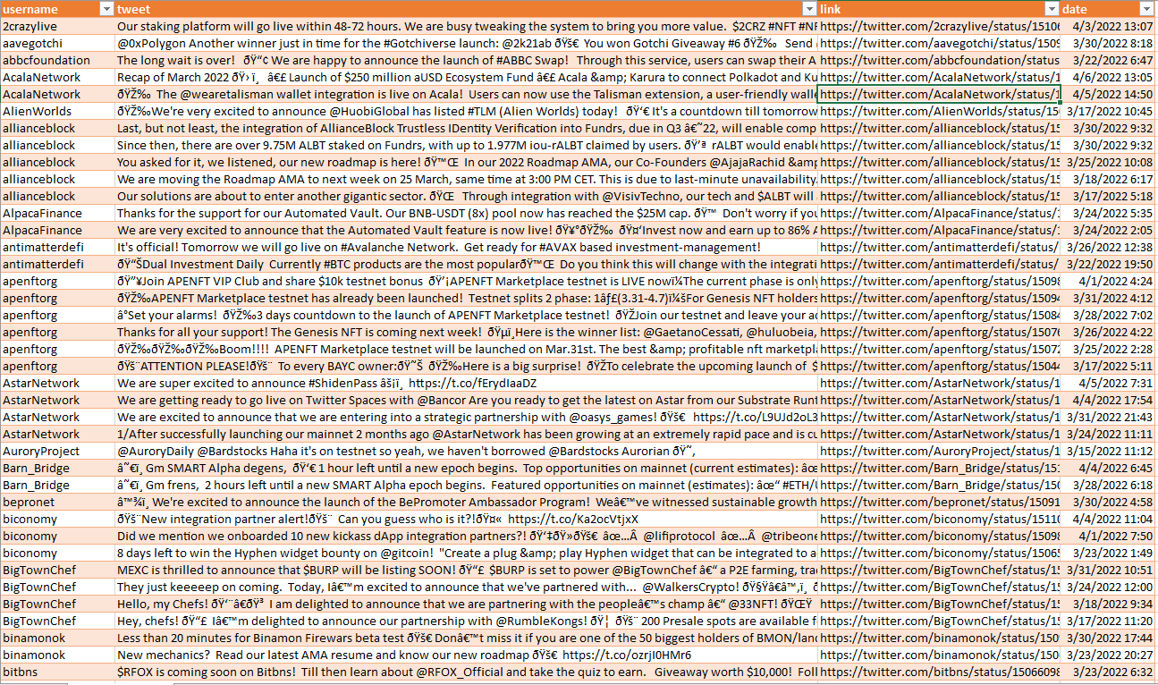

Slide 24

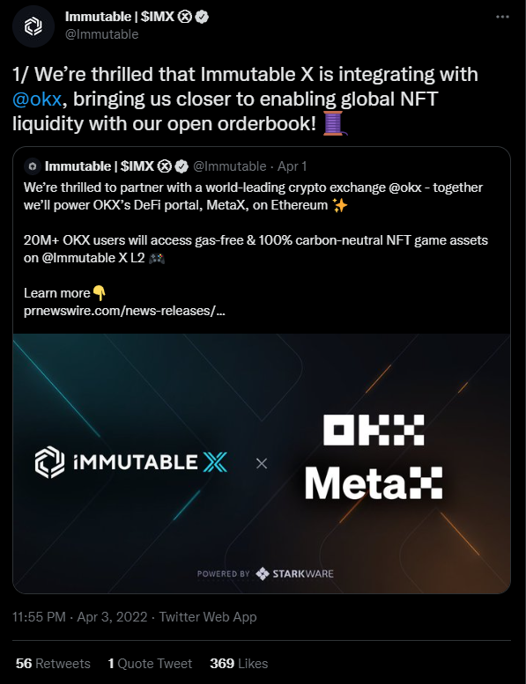
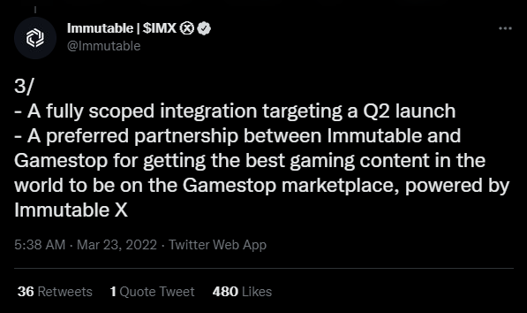
Immutable (IMX)

Slide 25
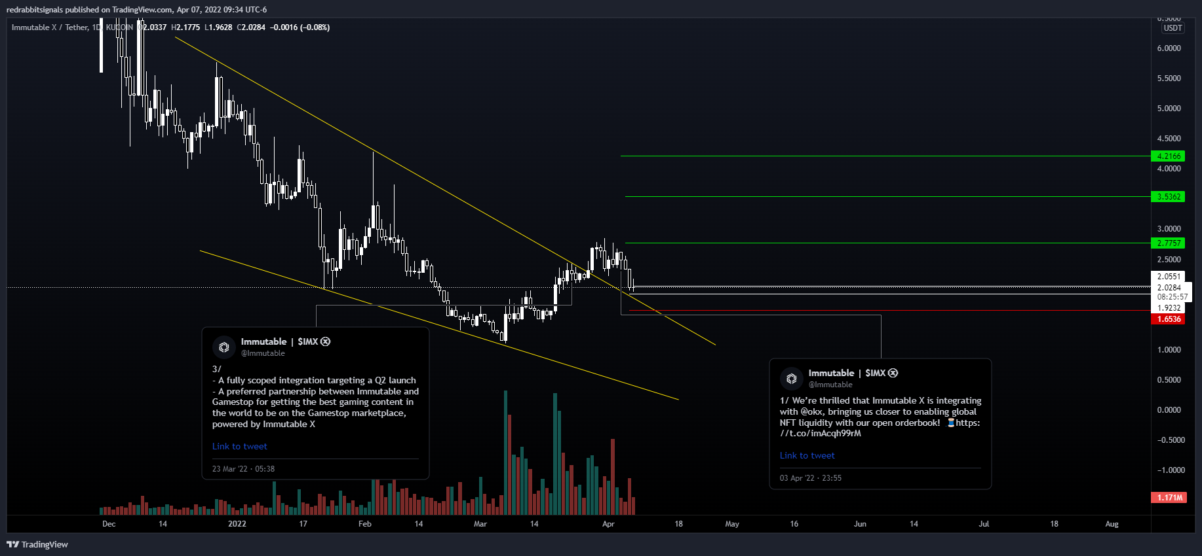

Slide 26
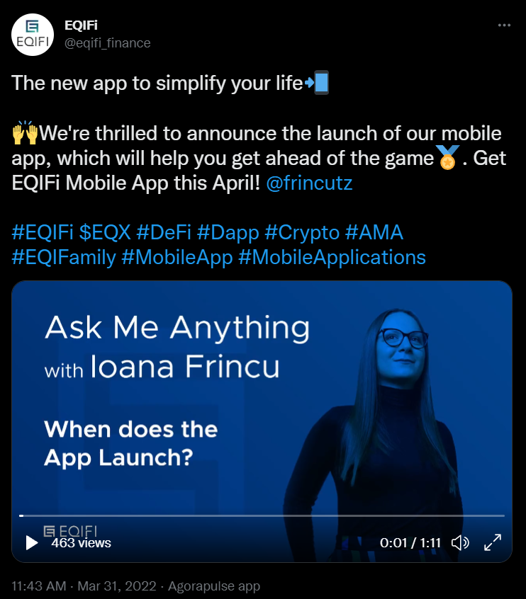
EQIFI Finance (EQX)

Slide 27
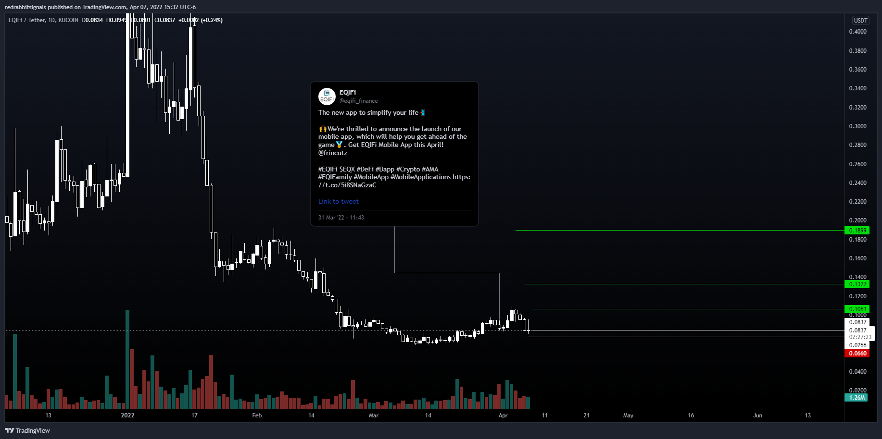

Slide 28
What can be improved?
Keyword Bigram Selection can be improved to filter the noise even further
Deployed to a virtual server or AWS to run 24/7 and return tweets as they are posted
More research on the relationship between different events and price movements

Slide 29
UPCOMING EVENTS INTEL STRATEGY
Data Science & Cryptocurrency Trading

Slide 30
How to get a list of cryptos with the most upcoming events from CoinMarketCal?
v
Python Libraries
Pandas
Twint
Pathlib
NLTK
Re
Counter
Other Platforms
Cryptocurrency projects may post about important events to their users or fanbase
Crypto fans FOMO into a crypto based on significant tweets
Experienced traders frontload news events that will happen in the future
Can increase the chances of successful trade when applying technical analysis
TradingView
Twitter

Slide 31
iMappe Philosophy
Description
30
A wonderful serenity has taken possession entire soul like these sweet mornings
A wonderful serenity
Description
A wonderful serenity taken possession entire soul these sweet mornings
5K
Description
A wonderful serenity
A wonderful serenity taken possession
Description
A wonderful serenity taken possession
Create Beautiful, Interactive Maps With Ease
A wonderful serenity has taken possession entire soul like these
Your Easy-to-use Map Building Tools

Slide 32
iMappe Across Industries
Description
Description
A wonderful serenity taken possession entire soul these sweet mornings
Description
A wonderful serenity taken possession
A wonderful serenity taken possession
A wonderful serenity has taken possession of my entire soul, like these sweet mornings of spring which I enjoy with my whole heart. I am alone, and feel the charm of existence in this spot, which was created for the bliss of souls like mine.
Your Easy-to-use Map Building Tools

Slide 33

Demo Time : Pre - Launch
Description
A wonderful serenity taken
Description
A wonderful serenity taken
01
Description
A wonderful serenity taken
A wonderful serenity has taken possession entire soul like these sweet mornings
Your Easy-to-use Map Building Tools

Slide 34
Demo Time : Post - Launch
01.
A wonderful serenity has taken possession of my entire soul
30,8% - 42,8%
02
02.
A wonderful serenity has taken possession of my entire soul
42,8% - 61,4%
03.
A wonderful serenity has taken possession of my entire soul
Description
A wonderful serenity has taken possession of my entire soul like these sweet mornings of spring which I enjoy with whole
61,4% - 96,2%
Your Easy-to-use Map Building Tools

Slide 35
iMappe Best Impact tools
Description
A wonderful serenity has taken possession entire soul like these sweet mornings
Description
A wonderful serenity taken possession
Description
A wonderful serenity taken possession entire soul these sweet mornings
Description
A wonderful serenity taken possession
Description
Description
A wonderful serenity taken possession
A wonderful serenity taken possession
Your Easy-to-use Map Building Tools

Slide 36
iMappe Product List
Description
Description
Description
A wonderful serenity
A wonderful serenity
A wonderful serenity
Description
Description
Description
A wonderful serenity
A wonderful serenity
A wonderful serenity
Description
Description
Description
A wonderful serenity
A wonderful serenity
A wonderful serenity
Description
Description
Description
A wonderful serenity
A wonderful serenity
A wonderful serenity
Your Easy-to-use Map Building Tools

Slide 37
iMappe Features List
Description
A wonderful serenity taken possession entire soul
Description
A wonderful serenity taken possession entire soul
A wonderful serenity has taken possession of my entire soul, like these sweet mornings of spring which I enjoy with my whole heart. I am alone, and feel the charm of existence in this spot, which was created for the bliss of souls like mine.
I am so happy, my dear friend, so absorbed in the exquisite sense of mere tranquil existence, that I neglect my talents.
Description
A wonderful serenity taken possession entire soul
Description
A wonderful serenity taken possession entire soul
Description
A wonderful serenity taken possession entire soul
www.yourwebsite.com
Description
A wonderful serenity taken possession entire soul
Your Easy-to-use Map Building Tools

Slide 38
Why Choose iMappe ?
Description
A wonderful serenity has taken possession of my entire soul, like these sweet mornings of spring which I enjoy with my whole heart. I am alone, and feel the charm of existence in this spot, which was created for the bliss of souls like mine.
I am so happy, my dear friend, so absorbed in the exquisite sense of mere tranquil existence, that I neglect my talents.
A wonderful serenity possession of my entire soul, like these sweet mornings of spring which
Description
Description
Description
Description
Your Easy-to-use Map Building Tools

Slide 39
Create beautiful, Interactive Maps With Ease
Break
A wonderful serenity has taken possession of my entire soul, like these sweet mornings of spring which I enjoy with my whole heart. I am alone, and feel
www.yourwebsite.com
Your Easy-to-use Map Building Tools

Slide 40
Keyword Research
INTEGRATION
TESTNET
UPDATE
APP
MAINNET
ROADMAP
RELEASE
PARTNERSHIP
LAUNCH

Slide 41

iMappe for Website
A wonderful serenity has taken possession of my entire soul, like these sweet mornings of spring which I enjoy with my whole heart. I am alone, and feel the charm of existence in this spot, which was created for the bliss of souls like mine.
I am so happy, my dear friend, so absorbed in the exquisite sense of mere tranquil existence, that I neglect my talents.
www.yourwebsite.com
Your Easy-to-use Map Building Tools

Slide 42


iMappe for Mobile
A wonderful serenity has taken possession of my entire soul, like these sweet mornings of spring which I enjoy with my whole heart. I am alone, and feel the charm of existence in this spot, which was created for the bliss of souls like mine.
I am so happy, my dear friend, so absorbed in the exquisite sense of mere tranquil existence, that I neglect my talents.
www.yourwebsite.com
Your Easy-to-use Map Building Tools

Slide 43
iMappe Pricing Package
Description
Description
Description
$250,00
$450,00
$750,00
A wonderful serenity has taken possession
A wonderful serenity has taken possession
A wonderful serenity has taken possession
Get Started
Get Started
Get Started
Your Easy-to-use Map Building Tools

Slide 44
iMappe User Testimonial
Our Client List :
A wonderful serenity has taken possession of my entire soul, like these sweet mornings of spring which I enjoy with my whole heart. I am alone, and feel the charm of existence in this spot, which was created for the bliss of souls like mine.
Scarlett Garcia
Developer Team
A wonderful serenity has taken possession of my entire existence in this spot, which was created the bliss souls like mine am so talents should incapable drawing single lovely sun strikes the upper surface
Client Rating :
Your Easy-to-use Map Building Tools

Slide 45
iMappe Business Key Factor
Description
Description
A wonderful serenity has taken possession entire soul these sweet mornings
A wonderful serenity has taken possession entire soul these sweet mornings
Description
Possession of my entire soul
Description
Possession of my entire soul like
Possession of my entire soul
Possession of my entire soul like
A wonderful serenity has taken possession of my entire soul, like these sweet mornings I am alone, and feel the charm of existence in this spot, which was created for the bliss of souls like mine.
Your Easy-to-use Map Building Tools

Slide 46
iMappe Business Process
Description
Description
Description
Description
Description
Description
Your Easy-to-use Map Building Tools

Slide 47
iMappe Business Diagram
Description
Description
A wonderful serenity taken possession entire
A wonderful serenity taken possession entire
Description
Description
A wonderful serenity taken possession entire
A wonderful serenity taken possession entire
Description
Description
A wonderful serenity taken possession entire
A wonderful serenity taken possession entire
A wonderful serenity has taken possession of my entire soul, like these sweet mornings I am alone, and feel the charm of existence in this spot, which was created for the bliss of souls like mine.
Your Easy-to-use Map Building Tools

Slide 48
iMappe Business Map Region
+242K
+451K
01
Description
Description
Description
A wonderful serenity has taken possession of my entire soul, like these sweet mornings of spring which charm of existence in this spot, which was created for the bliss of souls like mine.
I am so happy, my dear friend, so absorbed in the exquisite sense of mere tranquil existence
A wonderful serenity entire
02
Description
A wonderful serenity entire
www.yourwebsite.com
Your Easy-to-use Map Building Tools

Slide 49
iMappe Market Validation
12,2%
Description
12,9%
Description
A wonderful serenity
A wonderful serenity
36,8%
21,2%
Description
Description
A wonderful serenity
A wonderful serenity
A wonderful serenity has taken possession of my entire soul, like these sweet mornings of spring which I enjoy with my whole heart alone and feel the charm of existence in this spot
Your Easy-to-use Map Building Tools

Slide 50
iMappe Market Share
+265K
A wonderful serenity
+344K
A wonderful serenity
A wonderful serenity has taken possession of my entire soul, like these sweet mornings of spring which I enjoy with my whole heart alone and feel the charm of existence in this spot
+562K
A wonderful serenity
Your Easy-to-use Map Building Tools

Slide 51
iMappe Market Distribution
+232,874
Description
Description
A wonderful serenity has taken possession
+265
A wonderful serenity has taken possession
+134
A wonderful serenity has taken possession
Your Easy-to-use Map Building Tools

Slide 52
iMappe Market Potential
65.95%
Description
A wonderful serenity taken possession entire soul
34.06%
Description
A wonderful serenity taken possession entire soul
A wonderful serenity has taken possession of my entire soul, like these sweet mornings of spring which I enjoy with my whole heart alone and feel the charm of existence in this spot
Your Easy-to-use Map Building Tools

Slide 53
iMappe Management Teams
Julia Garcia
Adam Garcia
Lucas Garcia
Adinda Garcia
Management Team
Management Team
Management Team
Management Team
A wonderful serenity has taken possession
A wonderful serenity has taken possession
A wonderful serenity has taken possession
A wonderful serenity has taken possession
Your Easy-to-use Map Building Tools

Slide 54
iMappe Developer Teams
Scarlett Garcia
Martin Garcia
Adam Garcia
Developer Team
Developer Team
Developer Team
Your Easy-to-use Map Building Tools

Slide 55
iMappe Developer Teams
A wonderful serenity has taken possession of my entire soul, like these sweet mornings of spring which I enjoy with my whole heart. this spot, which was created
Developer Teams
Find Me On :
A wonderful serenity has taken possession of my entire soul, like these sweet mornings of spring which I enjoy with my whole heart. I am alone, and feel the charm of existence in this spot, which
A wonderful serenity has taken possession of my entire soul, like these sweet mornings of spring which I enjoy with my whole heart. this spot, which was created
www.yourwebsite.com
Developer Teams
Find Me On :
Your Easy-to-use Map Building Tools

Slide 56
Customer Services
Visit Us At :
15 Bland Street, Surry Hils, Block C
Sydney, Australia
http://yourwebsitehere.com
A wonderful serenity has taken possession of my entire soul, like these sweet
“ Create beautiful, Interactive Maps With Ease “
A wonderful serenity has taken possession entire soul like these sweet mornings
Your Easy-to-use Map Building Tools

Slide 57
Thank You For Your Attention
Your Easy-to-use Map Building Tools
A wonderful serenity has taken possession of my entire soul like these sweet mornings of spring which I enjoy with my whole heart.
www.yourwebsite.com

